Slide 1
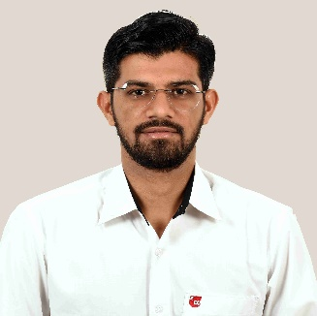
Unit-4
Essential Grammar
Foundational English
DU#2501HS102
Dr. Nitin H. Chauhan
Humanities and Science Department
nitin.chauhan@darshan.ac.in
9016705547

Slide 2

Looping
Topics
  Noun-Pronoun Agreement
  Subject-Verb Agreement
  Conditional Sentences
  Punctuation
  Determiners

Slide 3
Noun-Pronoun Agreement

Slide 4
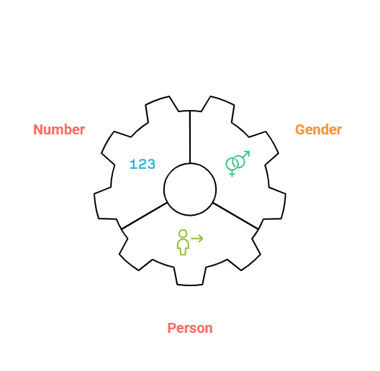
Noun-Pronoun Agreement
Noun-Pronoun Agreement refers to the grammatical agreement between the noun and the pronoun, the pronoun should match the noun it replaces:
  Gender (male, female, or thing)
    Shyam is my brother. He likes to draw.
    Meera joined the football team. She practices every evening.
    I bought a new mobile. It is very useful.
  Person (first, second, or third)
    I love reading books.
    You enjoy painting.
    He plays cricket.
  In number (singular or plural)
    The child is playing. It looks happy.
    The children are playing. They look happy.
Notes:
Image Ref: https://mentorplus.co.in/wp-content/uploads/2023/01/Parts-of-Speech-With-5-Examples-Each.jpg
https://images.app.goo.gl/3ziftbz12KYkYvmW8
https://www.shutterstock.com/search/similar/1819286891
https://www.pngwing.com/en/free-png-dhqabhttps://www.vectorstock.com/royalty-free-vector/policeman-cartoon-profession-vector-43031206

Slide 5
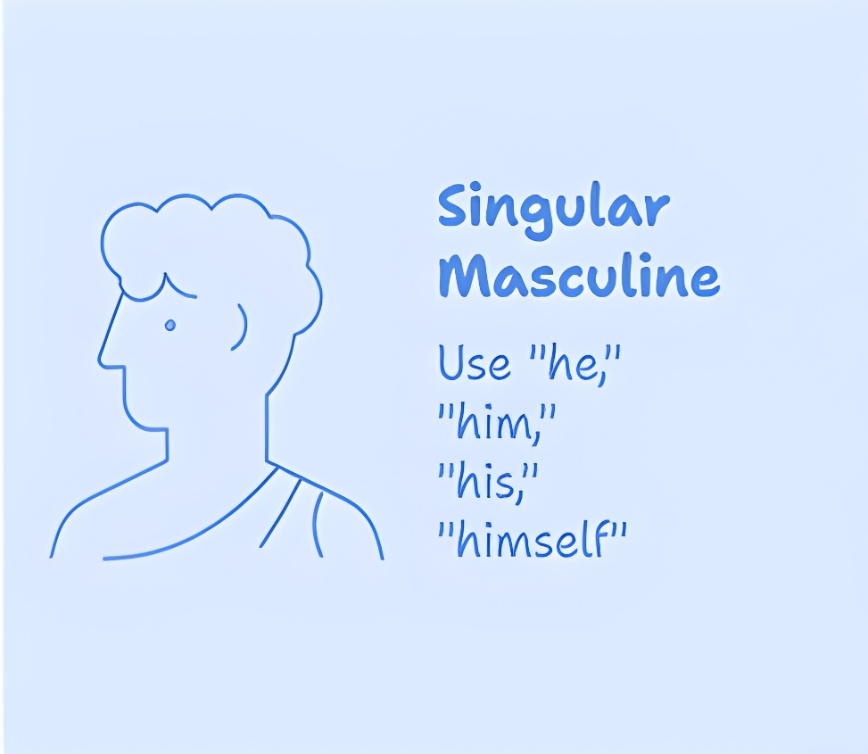
Noun-Pronoun Agreement
Rule 1: When referring to a singular masculine, use pronouns like “he,” “him,” “his,” and “himself.”
  Ravi is my friend. He is very helpful.
    masculine subject → pronoun he
  This boy is intelligent. Everyone likes him.
    masculine subject → pronoun him
  Arjun has lost his book.
    masculine subject → pronoun his
  The man solved the problem himself.
    masculine subject → pronoun himself
Notes:
Image Ref: https://mentorplus.co.in/wp-content/uploads/2023/01/Parts-of-Speech-With-5-Examples-Each.jpg
https://images.app.goo.gl/3ziftbz12KYkYvmW8
https://www.shutterstock.com/search/similar/1819286891
https://www.pngwing.com/en/free-png-dhqabhttps://www.vectorstock.com/royalty-free-vector/policeman-cartoon-profession-vector-43031206

Slide 6
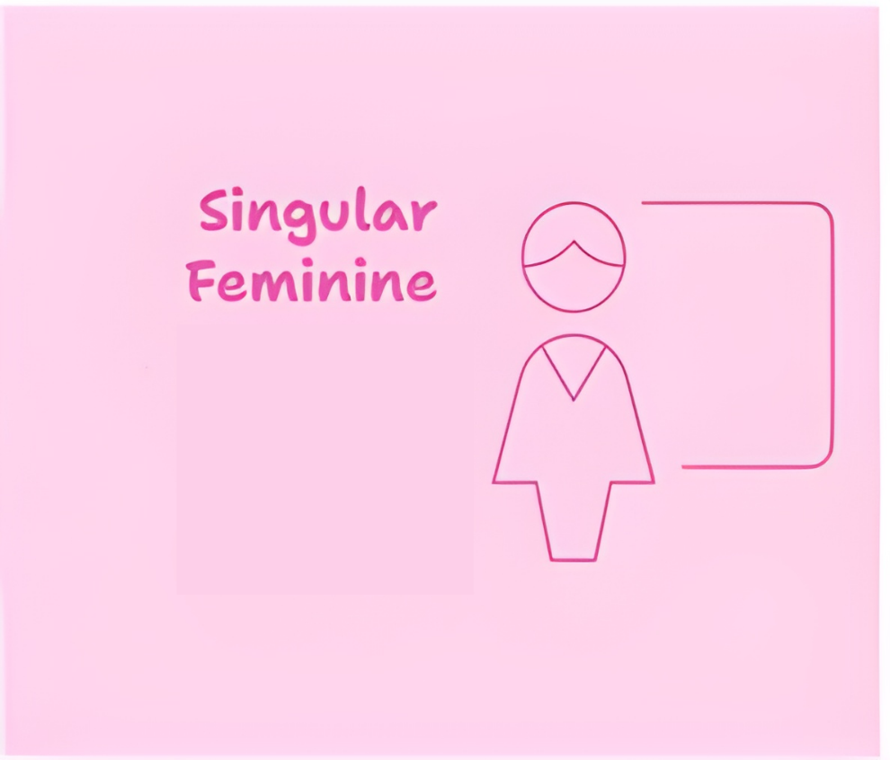




Noun-Pronoun Agreement
Rule 2: When talking about a singular feminine, use pronouns such as “she,” “her,” “hers,” and “herself.”
  Sita is a good singer. She sings beautifully.
    feminine subject → pronoun she
  This girl is my classmate. I know her.
    feminine subject → pronoun her
  Anita has forgotten her notebook.
    feminine subject → pronoun her
  The woman completed the work herself.
    feminine subject → pronoun herself
Notes:
Image Ref: https://mentorplus.co.in/wp-content/uploads/2023/01/Parts-of-Speech-With-5-Examples-Each.jpg
https://images.app.goo.gl/3ziftbz12KYkYvmW8
https://www.shutterstock.com/search/similar/1819286891
https://www.pngwing.com/en/free-png-dhqabhttps://www.vectorstock.com/royalty-free-vector/policeman-cartoon-profession-vector-43031206

Slide 7

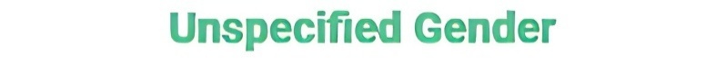



Noun-Pronoun Agreement
Rule 3: For non-living things and most animals, it is appropriate to use “it,” “its,” and “itself” as pronouns.
  The chair is broken. It needs to be repaired.
  The car is new. Its color is red.
  The computer shut down by itself.
Rule 4: If the noun refers to a person of any gender (e.g., person, pupil, scholar, reader), masculine pronouns are typically used.
  If a person works hard, he will succeed.
  Every pupil must bring his own notebook.
  The scholar presented his research at the conference.
  Each reader should bring his library card.
Notes:
Image Ref: https://mentorplus.co.in/wp-content/uploads/2023/01/Parts-of-Speech-With-5-Examples-Each.jpg
https://images.app.goo.gl/3ziftbz12KYkYvmW8
https://www.shutterstock.com/search/similar/1819286891
https://www.pngwing.com/en/free-png-dhqabhttps://www.vectorstock.com/royalty-free-vector/policeman-cartoon-profession-vector-43031206

Slide 8
Noun-Pronoun Agreement
Rule 5: The words “baby” and “child” can be used for both boys and girls, so we usually say “it” when talking about them.
  The baby is crying. I think it is hungry.
  A child was lost in the mall. Luckily, it was found by the security guard.
Rule 6: When the noun is plural and can be male or female, or is a non-living thing, we use they, them, their, theirs, themselves.
  The girls are singing. They sound great.
  The chairs are broken. We need to fix them.
  The students brought their books.
  The bags are new. Theirs are blue and white.
  The teachers introduced themselves before starting.
Notes:
Image Ref: https://mentorplus.co.in/wp-content/uploads/2023/01/Parts-of-Speech-With-5-Examples-Each.jpg
https://images.app.goo.gl/3ziftbz12KYkYvmW8
https://www.shutterstock.com/search/similar/1819286891
https://www.pngwing.com/en/free-png-dhqabhttps://www.vectorstock.com/royalty-free-vector/policeman-cartoon-profession-vector-43031206

Slide 9

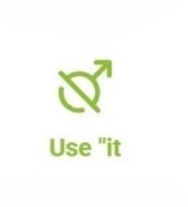
Noun-Pronoun Agreement
Rule 7: We usually use “it” to talk about animals, even if the word for the animal suggests a specific gender, like “cow” or “bull.”
  A bull ran across the road. It looked very strong.
  The cow is in the field. It is eating grass.
  A lion is resting under the tree. It looks tired.
  A parrot is sitting in the cage. It is making a lot of noise.
  The elephant is crossing the river. It is very big.
  A monkey is climbing the tree. It is very quick.
Notes:
Image Ref: https://mentorplus.co.in/wp-content/uploads/2023/01/Parts-of-Speech-With-5-Examples-Each.jpg
https://images.app.goo.gl/3ziftbz12KYkYvmW8
https://www.shutterstock.com/search/similar/1819286891
https://www.pngwing.com/en/free-png-dhqabhttps://www.vectorstock.com/royalty-free-vector/policeman-cartoon-profession-vector-43031206

Slide 10
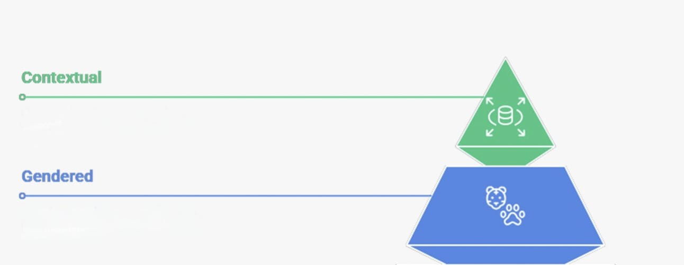
Noun-Pronoun Agreement
Rule 8: We use "he" or "she" for animals when the context or situation makes their gender important. (Pet animals, which are often considered as members of the family, are usually referred to using pronouns appropriate to their gender.)
  We usually call our pet dog Rocky a part of the family. He loves playing in the garden and waits by the door when it’s time for a walk. Our neighbor has a cat named Misty. She is very friendly and often visits our house.
Notes:
Image Ref: https://mentorplus.co.in/wp-content/uploads/2023/01/Parts-of-Speech-With-5-Examples-Each.jpg
https://images.app.goo.gl/3ziftbz12KYkYvmW8
https://www.shutterstock.com/search/similar/1819286891
https://www.pngwing.com/en/free-png-dhqabhttps://www.vectorstock.com/royalty-free-vector/policeman-cartoon-profession-vector-43031206

Slide 11



Noun-Pronoun Agreement
Rule 9: Words begin with every-(everyone, everybody, everything) are singular, and must therefore be referred to by the singular pronouns.
  Everyone must check his answers twice.
  Everybody shared his opinion.
  Everything in the box has its label.
Everybody
Everyone
Everything
Notes:
Image Ref: https://mentorplus.co.in/wp-content/uploads/2023/01/Parts-of-Speech-With-5-Examples-Each.jpg
https://images.app.goo.gl/3ziftbz12KYkYvmW8
https://www.shutterstock.com/search/similar/1819286891
https://www.pngwing.com/en/free-png-dhqabhttps://www.vectorstock.com/royalty-free-vector/policeman-cartoon-profession-vector-43031206

Slide 12
Subject-Verb Agreement
Notes:
Gif Reference: https://tenor.com/view/tkthpsharma-gif-23317246

Slide 13

Subject-Verb Agreement
Look at the following sentences and find whether they are correct or not.
  Prabha and Seema is here.
  Kavish, Raj and Reena goes to the same school.
  She and her friend has arrived.
  He and I was playing in the garden.
The above given sentences are wrong because the subject in each of sentences being plural need to have the plural verb.
  Prabha and Seema are here.
  Kavish, Raj and Reena go to the same school.
  She and her friend have arrived.
  He and I were playing in the garden.
A verb must agree with its subject in number and person.
Use Plural Verb?
Use Singular Verb?

Slide 14
Subject-Verb Agreement
Rule 1 : Singular subject takes singular verb.
  My brother plays football well.
  Rina works at a bank.
  A bird sings in the morning.
Rule 2: Singular subjects joined by certain connectors takes singular verb. i.e. as well as, along with, together with, accompanied by.
  Ravi, as well as his brother, plays the guitar.
  The cat, along with its kitten, is hiding under the bed.
  The manager, together with his team, is working on the project.
  The principal, accompanied by his staff, visits the classrooms.

Slide 15
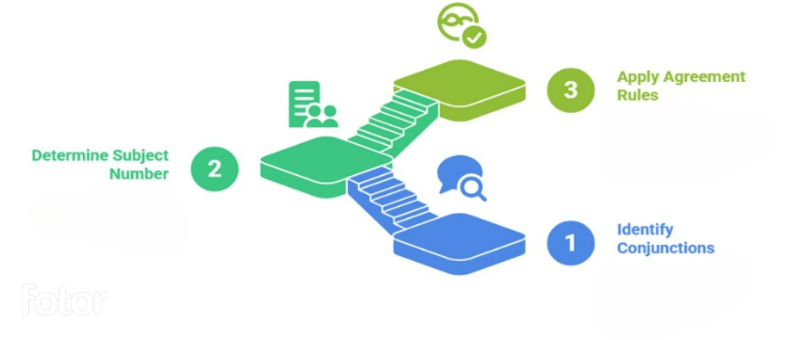
Subject-Verb Agreement
Rule 3 : Singular subjects joined by, ‘either...or’, ‘neither...nor’ take a singular verb. Plural subject joined by these connectors take plural verb.
  Either Asha or Anjali is bringing the cake for the party.
  (Both subjects are singular, so we use the singular verb “is.”)
  Neither the boys nor the girls were interested in the activity.
  (Plural subjects take the plural verb “were.”)

Slide 16
Subject-Verb Agreement
Rule 4: When singular and plural subjects are joined by, ‘either…or’, ‘neither…nor’ the verb agrees with the nearest subject. If the nearest subject is plural, the verb will be plural. If the nearest subject is singular, the verb will be singular.
  Either the teacher or the students are going to arrange the program.
    nearest subject = students → plural → are
  Either the students or the teacher is responsible for this mistake.
    nearest subject = teacher → singular → is
  Neither the manager nor the workers are willing to accept the proposal.
    nearest subject = workers → plural → are
  Either Manjit or his brothers have broken the window glass.
    nearest subject = brothers → plural → have
  Neither the tractors nor the trailer was sold.
    nearest subject = trailer → singular → was

Slide 17
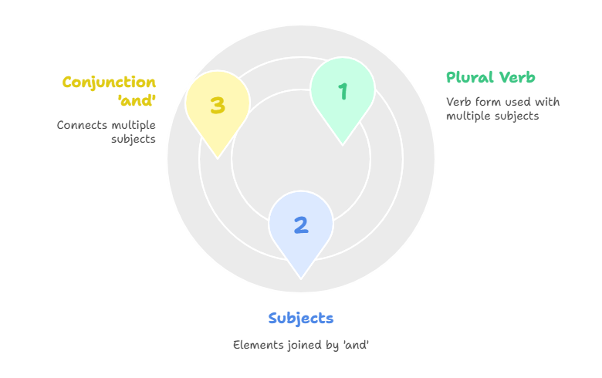
Subject-Verb Agreement
Rule 5: Subjects joined by ‘and’ take a plural verb.
  Ram and Shyam are good friends.
    two subjects joined by and → plural verb are
  The teacher and the students were present in the meeting.
    teacher + students → plural verb were
  Honesty and hard work bring success.
    two qualities joined by and → plural verb bring
  My brother and I are going to the market.
    brother + I → plural verb are
  The singer and the musician have arrived for the program.
    Two persons → plural verb have

Slide 18
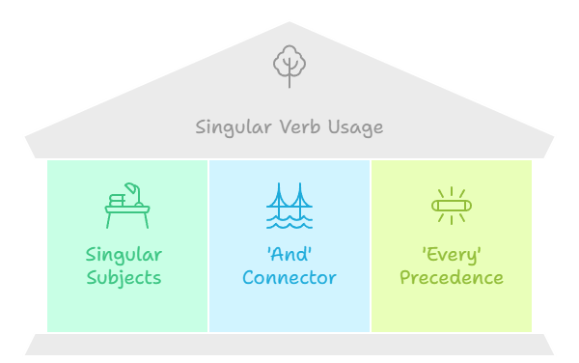
Subject-Verb Agreement
Rule 6: Singular subjects joined by ‘and’ and preceded by ‘every’ take a singular verb.
  Every boy and every girl is invited to the function.
    each subject is considered separately → singular verb is
  Every teacher and every student has to attend the seminar.
    treated as individual responsibility → singular verb has
  Every pen and every notebook belongs to the library.
    singular ownership → singular verb belongs
  Every table and every chair was arranged neatly in the hall.
    Focus is on each single object one by one → singular verb was
  Every parent and every guardian cares for the child.
    Treated as individual responsibility → singular verb cares

Slide 19
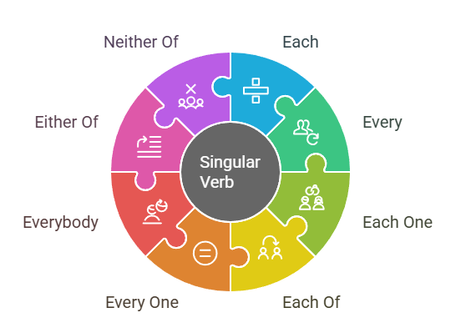
Subject-Verb Agreement
Rule 7: ‘Each’, ‘every’, ‘each one’, ‘each of’, ‘every one’, ‘everybody’, ‘either of’, ‘neither of’ take a singular verb.
  Each student is responsible for their own work.
  Every bird is sitting on a different branch.
  Each one of the flowers is blooming beautifully.
  Each of the answers is correct.
  Every one of the letters has been delivered.
  Everybody enjoys the annual college festival.
  Either of the options is fine with me.
  Neither of the boys is ready for the match.

Slide 20
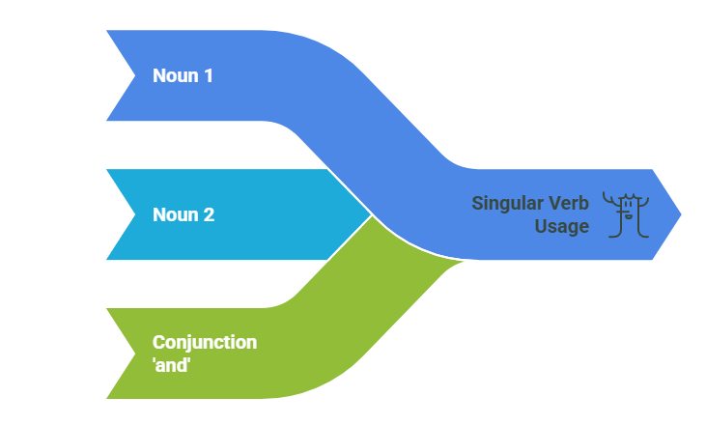
Subject-Verb Agreement
Rule 8: If the two nouns are joined by ‘and’ refer to the same person or thing the verb is singular not plural.
  Our doctor and family friend is visiting us today.
  The principal and headmaster is addressing the students.
  The poet and philosopher is speaking at the event.
  The owner and manager of this shop is very polite.
  The singer and dancer is performing tonight.
  The chairman and director of the company is arriving soon.
  Our neighbor and friend is moving to Delhi.
  My teacher and guide has encouraged me a lot.

Slide 21
Subject-Verb Agreement
Rule 9: Introductory ‘there’ in the beginning of a sentence can have singular or plural verb form. It depends on the subject which follow the verb.
  There is a pen on the table.
  There are two books on the table.
  There is a student waiting outside.
  There are many students in the library.
  There is a problem with this computer.
  There are several errors in your answer sheet.
  There is a bird sitting on the branch.
  There are birds flying in the sky.

Slide 22
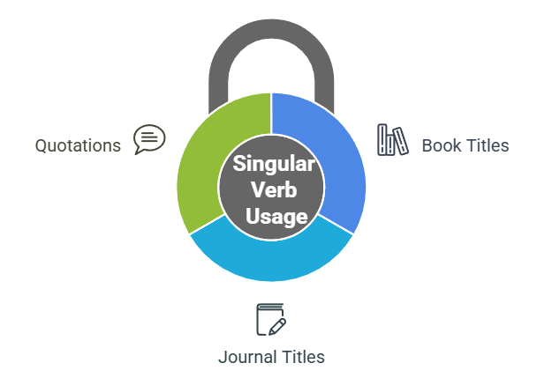
Subject-Verb Agreement
Rule 10: When the subject is title of a book or a journal, a quotation expressing a single idea, the verb is singular.
  “Friends” is my favorite TV show.
  “Statistics for Beginners” is a helpful book.
  “Time is money” is something my teacher always says.
  “The World of Science” is a useful journal for students.
  “Unity is strength” is an old saying.
  “Honesty is the best policy” is what my parents taught me.
  “The Hindustan Times” is widely read across India.
  “The Bhagavad Gita” is a sacred text of Hinduism.
  “Knowledge is power” is a truth we cannot deny.

Slide 23
Subject-Verb Agreement
Rule 11: Some nouns are always used in the plural form because they naturally refer to objects made of two parts, groups, or abstract ideas. Since they are plural in form and meaning, they always take a plural verb.
  Scissors are on the table.
  Trousers are dirty.
  Spectacles are missing.
  Shoes are lying at the door.
  Jeans are popular among youngsters.
  Shorts are in the cupboard.
  Socks are hanging on the rope.
  Binoculars are useful for bird watching.
  Slippers are under the bed.
  Goggles are fashionable these days.

Slide 24
Subject-Verb Agreement
Rule 12: When fractions or percentages are used with of, the verb depends on the noun that follows.
  Fifty percent of the work is done.
    work (uncountable) → singular verb is
  Fifty percent of the people are absent.
    people (countable plural) → plural verb are
  One-third of the cake is missing.
    cake (singular) → singular verb is
  One-third of the students were late.
    students (plural) → plural verb were
  Some of the water is wasted.
    water (uncountable) → singular verb is
  Some of the books are old.
    books (plural) → plural verb are

Slide 25
Subject–Verb Agreement Practice
Fill in the blanks with the correct form of the verb given in brackets.
  Fifty percent of the people __________ absent. (be)
  Fifty percent of the people are absent.
  Our doctor and family friend __________ visiting us today. (be)
  Our doctor and family friend is visiting us today.
  Ravi, as well as his brother, __________ the guitar. (play)
  Ravi, as well as his brother, plays the guitar.
  There __________ many students in the library. (be)
  There are many students in the library.
  Each of the answers __________ correct. (be)
  Each of the answers is correct.

Slide 26
Subject–Verb Agreement Practice
Fill in the blanks with the correct form of the verb given in brackets.
  My brother __________ football very well. (play)
  My brother plays football very well.
  Every pen and every notebook __________ to the library. (belong)
  Every pen and every notebook belongs to the library.
  Scissors __________ on the table. (be)
  Scissors are on the table.
  “Unity is strength” __________ an old saying. (be)
  “Unity is strength” is an old saying.
  Everybody __________ the annual college festival. (enjoy)
  Everybody enjoys the annual college festival.

Slide 27
Subject–Verb Agreement Practice
Fill in the blanks with the correct form of the verb given in brackets.
  The cat, along with her kittens, always __________ under the bed. (hide)
  The cat, along with her kittens, always hides under the bed. (hide)
  There __________ a pen on the table. (be)
  There is a pen on the table.
  Neither the boys nor the girls __________ interested in the activity. (be)
  Neither the boys nor the girls were interested in the activity.
  Either Asha or Anjali __________ bringing the cake for the party. (be)
  Either Asha or Anjali is bringing the cake for the party.
  Either the teacher or the students __________ going to arrange the program. (be)
  Either the teacher or the students are going to arrange the program.

Slide 28
Conditional Sentences
Notes:
Gif Reference: https://tenor.com/view/tkthpsharma-gif-23317246

Slide 29
Conditional Sentences
Conditional sentences are sentences that talk about a condition (something that might happen, or might have happened) and the result (what follows from that condition).
શરતી વાક્ય એવા વાક્ય હોય છે જે કોઈ શરત (જે બનવાનું હોય તે) અને તેનું પરિણામ (તે શરત પૂર્ણ થવાથી શું થાય છે) દર્શાવે છે.
Conditional sentences are also called if-clauses.
They usually have two parts:
If it rains, I will stay home.
જો વરસાદ પડે, તો અમે ઘરમાં રહીશું.
If-clause
(condition)
Main clause
(result)
જો વાક્ય
(શરત)
મુખ્ય વાક્ય
(પરિણામ)

Slide 30
Types of Conditional Sentences
Types of Conditional Sentences
Zero Conditional
First Conditional
Second Conditional
Third Conditional

Slide 31
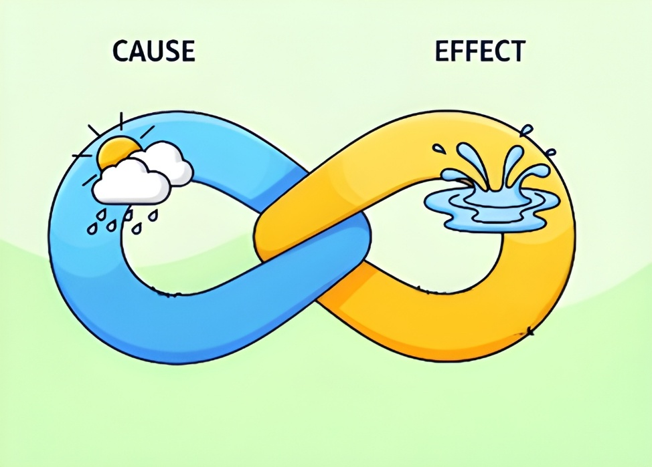
Conditional Sentences – Zero Conditional
Zero Conditional Sentences are used to express general truths, facts, laws of nature, or regular habits, things that are always true when the condition is met.
If it rains, the ground gets wet.
  જો વરસાદ પડે તો જમીન ભીની થઈ જાય છે.
Structure:
Usage:
  Used for universal truths, scientific facts, habits, or rules.
  The result is always the same whenever the condition happens.
  The sentence uses present tense, and it talks about things that are
  always true.
If
+
Simple Present Tense
+
Simple Present Tense

Slide 32
Conditional Sentences – Zero Conditional
Examples:
  If you mix red and blue, you get purple.
  If children eat too much sugar, they get cavities.
  If you press this button, the machine starts.
  If you heat water to 100°C,
  If I don’t water the plants,
  If people eat too much junk food,
Note:
  "If" can often be replaced by "when" in zero conditionals without changing the meaning.
  અર્થ બદલ્યા વિના "જો" ને ઘણીવાર ઝીરો કન્ડિશનલ્સમાં "જ્યારે" દ્વારા બદલી શકાય છે.
    If you heat ice, it melts.
    When you heat ice, it melts.
it boils.
they die.
  they get sick.

Slide 33
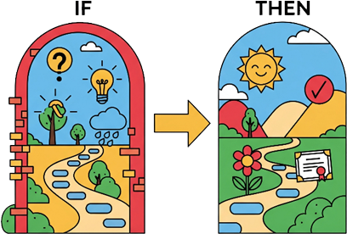
Conditional Sentences – First Conditional
First Conditional Sentences are used to talk about a probable or possible future event and its likely result.
આ વાક્યોનો ઉપયોગ સંભવિત ભવિષ્યની ઘટના અને તેના સંભવિત પરિણામ વિશે વાત કરવા માટે થાય છે.
If you take the first step, you will unlock success.
  જો તમે પહેલું પગલું ભરશો, તો તમને સફળતા મળશે.
Structure:
Usage:
  Talks about real and possible situations in the future.
  Condition is realistic; the result is expected if the condition is fulfilled.
    શરત વાસ્તવિક છે; જો શરત પૂરી થાય તો પરિણામ અપેક્ષિત છે.
If
+
Simple Present Tense
+
Simple Future Tense

Slide 34
Conditional Sentences – First Conditional
Examples:
  If it rains tomorrow, we will cancel the picnic.
  If you study hard, you will pass the exam.
  If you call him now, he forgive you.
  If I see him, I tell him the news.
  If he calls me, I help him.
  If you don’t eat breakfast, you be hungry later.
Note:
  Modal verbs can replace will:
    If you study, you will pass. → If you study, you may pass.
    If you are free, you can join us.
    If you finish on time, you may leave early.
  Imperative is also possible:
    If you see her, tell her to call me.
will
will
will
will

Slide 35
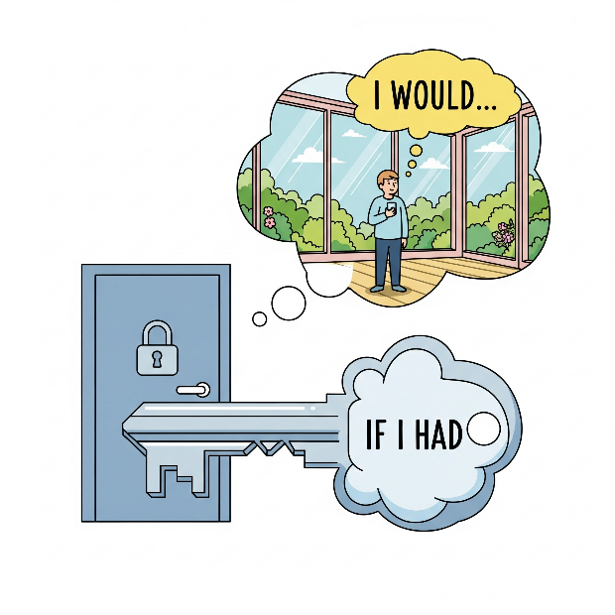
Conditional Sentences – Second Conditional
Second Conditional Sentences are used for imaginative or unlikely situations in the present or future. The condition is not true or is very unlikely to happen.
આ વાક્યોનો ઉપયોગ વર્તમાન કે ભવિષ્યમાં કાલ્પનિક અથવા અસંભવિત પરિસ્થિતિઓ માટે થાય છે. આ સ્થિતિ સાચી નથી અથવા થવાની સંભાવના નથી. (અશક્ય છે)
If I had the key, I would be in that house.
જો મારી પાસે ચાવી હોત, તો હું પેલા ઘરમાં હોત.
Structure:
Usage:
  To talk about imaginary, unlikely, or impossible situations in the present or future.
If
+
Simple Past Tense
+
Would
+
Main Verb

Slide 36
Conditional Sentences – Second Conditional
Examples:
  If I were rich, I would travel the world.
  If he studied more, he would get better grades.
  If she had a car, she would drive to work.
  If he had wings, he fly.
  If they invited me, I attend.
  If I knew his address, I visit him.
Note:
  We often use were instead of was in formal English:
    If I were you, I would talk to her.
would
would
would

Slide 37
Conditional Sentences – Third Conditional
Third Conditional Sentences are used to talk about a hypothetical past situation and its impossible result. (આ વાક્યોનો ઉપયોગ ભૂતકાળની કાલ્પનિક પરિસ્થિતિ અને તેના અશક્ય પરિણામ વિશે વાત કરવા માટે થાય છે.)
The condition was not met in the past, so the situation could not happen. (ભૂતકાળમાં આ સ્થિતિ પૂરી થઈ ન હતી, તેથી પરિસ્થિતિ બની શકી નહીં.)
If he had told me the truth, I would have helped him.
જો તેણે મને સત્ય કહ્યું હોત, તો હું તેને મદદ કરી હોત (કરત).
Structure:
Usage:
  To talk about situations in the past that did not happen (regrets, criticisms, missed chances).
If
+
Past Perfect
+
Would Have
+
Past Participle

Slide 38
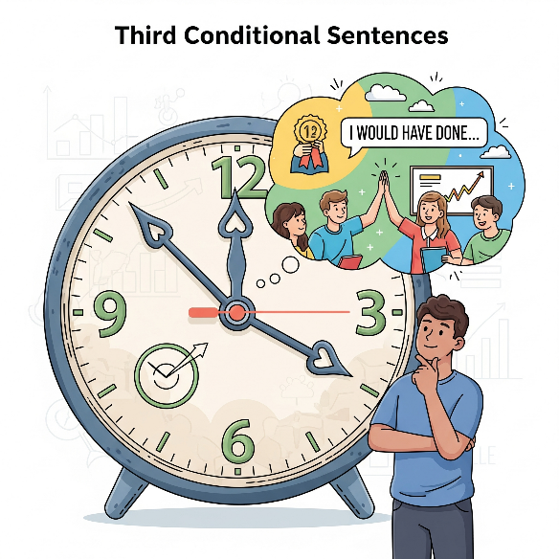
Conditional Sentences – Third Conditional
Examples:
  If I had studied harder, I would have passed the exam.
  If she had left earlier, she would have caught the train.
  If they had invited me, I would have attended the party.
  If he had listened, he made that mistake.
  If we had prepared better, we won the match.
  If the alarm had worked, we woken up on time.
Note:
  Used when the event cannot be changed (past is fixed).
  Often used in expressing blame/regret:
    If you had told me earlier, I would have helped you.
would not have
would have
would have

Slide 39
Comparison of Conditional Sentences
Comparison between Conditionals:
Type | If-Clause | Main Clause | Usage | Example
Zero Conditional | If + Present Simple | Present Simple | Facts, laws, general truths | If plants don’t get sunlight, they die.
First Conditional | If + Present Simple | Will + Verb (or may/can) | Real future possibilities | If you practice daily, you will improve quickly.
Second Conditional | If + Past Simple | Would + Verb | Unreal present/future | If I were you, I would accept the offer.
Third Conditional | If + Past Perfect | Would have + Past Participle | Unreal past (regrets / missed opportunity) | If I had saved money, I would have bought a car.

Slide 40
Conditional Sentences Practice
Read each sentence carefully and write whether it is First Conditional, Second Conditional, or Third Conditional.
  If I had known about the sale, I would have bought the laptop.
  Third Conditional
  If she drinks too much coffee, she gets headaches.
  Zero Conditional
  I would visit Paris if I had enough money.
  Second Conditional
  If he practices regularly, he will improve his guitar skills.
  First Conditional
  If I had been taller, I could have played basketball professionally.
  Third Conditional

Slide 41
Conditional Sentences Practice
Each sentence below contains an error in its conditional form. Carefully read each one and rewrite it correctly.
  She would have call you if she knew about the meeting.
  She would have called you if she had known about the meeting. → Third Conditional
  If it rains yesterday, we will stay indoors.
  If it had rained (yesterday), we would have stayed indoors. → Third Conditional
  He would help you if he will have time.
  He would help you if he had time. → Second Conditional
  If I am taller, I could reach the shelf.
  If I were taller, I could reach the shelf. → Second Conditional
  If the train will be on time, we would not miss it.
  If the train is on time, we will not miss it.→ First Conditional

Slide 42
Punctuation
Notes:
Gif Reference: https://tenor.com/view/tkthpsharma-gif-23317246

Slide 43
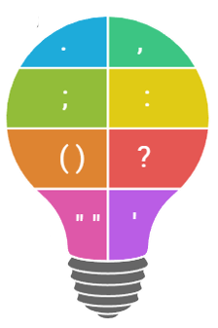
Punctuation
The word punctuation comes from the Latin punctum, meaning “point”. It makes written language clear and easy to understand.
It separates sentences or parts of a sentence using signs called punctuation marks.
The types of punctuation marks that we are going to study are:
  Full Stop
  The Comma
  The Semicolon
  The Colon
  The Parentheses
  The Question Mark
  The Apostrophe
  The Double Inverted Comma
  The Single Inverted Comma
  Use of Double Inverted Comma with other Punctuation
Full Stop
Comma
Semicolon
Colon
Parentheses
Question Mark
Double Inverted Comma
Apostrophe

Slide 44
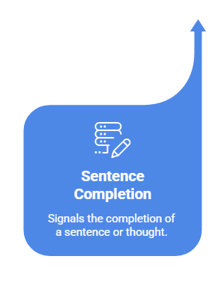
The Full Stop (.)
A full stop (.) shows that a sentence has come to an end.
  It is used at the end of a declarative or an imperative sentence.
    I live in Mumbai.
    He is a good student.
    Go and bring some water.
Sentences expressing requests end with full stops, not question marks.
  May I send you a cup of tea. (request)
  Will you kindly send me any more information you get on the matter. (request)

Slide 45
The Full Stop (.)
The full stop is used after abbreviations and initials.
  Abbreviation
  Initials
Note: When a sentence ends with an abbreviation, one full stop is sufficient for both the abbreviation and the sentence.
Dr.
Mr.
Ltd.
Prof.
St.
Capt.
Adj.
Jr.
A. P. J. Abdul Kalam
R. K. Narayan
P. V. Sindhu
M. K. Gandhi
C. V. Raman
We stayed at Sunrise Hotels Pvt. Ltd.
His office is in Washington, D.C.

Slide 46

The Comma (,)
The Comma (,) is the shortest pause, and is used to separate a series of words in the same construction.
  He wrote his exercise neatly, quickly and correctly.
  We must work carefully, honestly and sincerely.
  The room was painted red, blue, green and yellow.
Note: We use a comma before and in special cases, like the Oxford comma (used mostly in American English for clarity) or in long/complex sentences.
  I bought apples, bananas, and oranges.
  She finished her homework, and then she went out to play.
  At the shop, I bought pens, pencils, and erasers.

Slide 47
The Comma (,)
When we talk directly to a person in a sentence, we use a comma to separate the name or title of that person. This is called a vocative comma.
  How are you, Mohan?
    Here, Mohan is the person being addressed, so we put a comma before it.
  Sit down, children.
    Here, children is the person (group) being addressed, so we put a comma before it.
When we quote someone’s exact words in a sentence, we use commas (or sometimes colons) to separate the quotation from the rest of the sentence.
  “Exactly so,” said Alice.
  She said, “I am very happy today.”
  Rani said, “I will help you with your homework.”
  The teacher said, “Please open your books.”

Slide 48
The Semicolon (;)
Connecting Closely Related Independent Clauses
  A semicolon is used to join two independent clauses (complete sentences) that are closely related in meaning but not joined by a conjunction (like "and," "but," or "or").
    I like coffee; she prefers tea.
    She loves reading; he prefers watching movies.
Introducing Complex List
  A semicolon is used to separate items in a complex list, especially when the items themselves contain commas.
    We will visit three cities this summer Paris, France, Berlin, Germany, and Tokyo, Japan.
    We will visit three cities this summer: Paris, France; Berlin, Germany; and Tokyo, Japan.
    The team includes Mayank, the leader, Sneha, the coordinator, and Ravi, the assistant.
    The team includes Mayank, the leader; Sneha, the coordinator; and Ravi, the assistant.
✘
✔
✘
✔

Slide 49
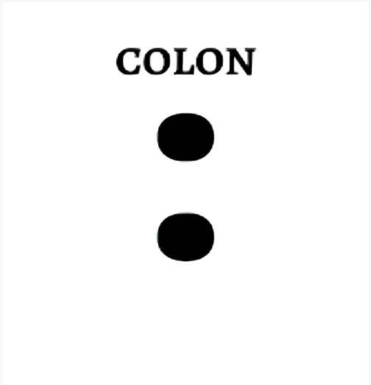
The Colon (:)
Introducing List
  Use a colon to introduce a list of items after a complete sentence.
    The load distribution follows this pattern: uniform, point, and varying loads.
    The program requires the following inputs: user name, password, and security key.
Introducing an Explanation or Clarification
  Use a colon to introduce an explanation, clarification, or further detail related to the sentence.
    She had only one goal: to win the competition.
    There is one rule in this class: respect each other.
Introducing a Quote
  Use a colon to introduce a direct quote or statement after an independent clause.
    He always says: “Hard work pays off.”
    The teacher reminded us: “Honesty is the best policy.”

Slide 50

The Parentheses ( )
Adding Extra or Explanatory Information
  They are used to insert extra information or clarification in a sentence. The sentence remains meaningful even if the words inside parentheses are removed.
    My brother (who is an engineer) works in Bangalore.
    The new phone (which I bought yesterday) has excellent features.
Giving Meanings or Clarifications
  Parentheses can be used to provide the meaning of a difficult word, abbreviation, or concept.
    She suffers from insomnia (sleeplessness).
    The WHO (World Health Organization) works for global health.
Indicating Lists or Numbers
  Parentheses are often used to enclose numbers or letters in a list for clarity and organization.
    The project requires three things: (1) time, (2) patience, and (3) creativity.
    Please answer the following: (a) your name, (b) your age, (c) your address.

Slide 51
The Parentheses ( )
Showing Afterthoughts or Comments
  Parentheses can be used to add a personal remark, afterthought, or extra comment to a sentence.
    He finally agreed to join us (after a lot of convincing).
    The match was exciting (to say the least).
Indicating Alternatives or Optional Words
  Parentheses may enclose alternative words, spellings, or optional elements in a sentence.
    Each student should bring his (or her) notebook.
    The book(s) will be delivered tomorrow.
Enclosing Dates, Years, or Acronyms
  Parentheses are used to enclose dates, years, or the full forms of acronyms.
    World War II (1939–1945) changed the world.
    NASA (National Aeronautics and Space Administration) launched the spacecraft.

Slide 52

The Question Mark (?)
To Ask Direct Questions (Interrogative Sentences)
  Interrogative sentences are used to ask direct questions.
    What is your name?
    Do you like ice cream?
    Can you help me with this work?
Tag Questions
  Tag questions are statements followed by a short question at the end, often used to confirm or check information.
    You are coming with us, aren’t you?
    She can play the piano, can’t she?
Using a Question Mark for Multiple Questions in One Sentence
  When a sentence contains more than one question, a question mark can be used after each separate question instead of just one at the end. This clearly separates the questions and maintains clarity.
    Is it raining? Should we carry an umbrella?
    Did you finish your homework? Have you packed your bag?

Slide 53

The Apostrophe (‘)
Apostrophe for Possession
  To show possession for singular nouns, add an apostrophe + s.
    That is Ravi’s car. (The car belongs to Ravi)
    That is the dog’s tail.
  For plural nouns that already end with "s," add only an apostrophe (no additional "s").
    The teachers' staff room is on the second floor.
    The workers’ protest continued for hours. (Protest of the workers)
Apostrophe for Reductions
  An apostrophe is used to replace missing letters in contractions.
    It’s going to rain. (“It’s” is a contraction of “It is” or “It has”.)
    You’re going to love this movie. (“You’re” is a contraction of “You are”.)
    I’ve already completed the assignment. (“I’ve” is a contraction of “I have”.)
    How’s the weather today? (“How’s” is a contraction of “How is” or “How has”.)
    He won’t be able to attend. (“won’t” is a contraction of “Will not”.)

Slide 54

The Double Inverted Comma (“”)
Enclosing Direct Speech
  Double inverted commas are used to show the exact words spoken by someone.
    Ramesh said, “I will come tomorrow.”
    “Please close the door,” requested the teacher.
Quoting Text or Passages
  Used to enclose exact words taken from a book, article, or speech.
    The report stated, “Climate change is a global challenge.”
    ”In the play, Hamlet says, “To be, or not to be, that is the question.”
Highlighting Titles of Short Works
  Double inverted commas are used for titles of poems, short stories, articles, songs, or chapters.
    I loved reading “The Little Prince.”
    My favorite poem is “The Road Not Taken.”

Slide 55
The Double Inverted Comma (“”)
Indicating Special Words or Irony
  Sometimes, double inverted commas are used to highlight a word or show irony.
    He is really a “genius” at making mistakes.
    The word “temporary” didn’t seem very temporary in that context.
Note:
  The Double inverted commas are also called the quotation marks.
  In British English, single inverted commas (‘ ’) are often used instead, but double inverted commas (“ ”) are the most common in formal writing.

Slide 56
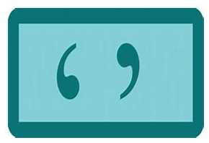
Single Inverted Comma (‘’)
Quotation Within a Quotation
  Single inverted commas are used when there is a quote inside another quote.
    Ramesh said, “I heard Sita say, ‘I will join the club tomorrow.’”
    The teacher asked, “Did he really say, ‘I don’t like homework’?”
Titles in British English
  In British English, single inverted commas are often used for titles of short works (poems, articles, chapters).
    I enjoyed reading ‘The Little Prince’.
    My favorite poem is ‘The Road Not Taken’.
    We discussed the article ‘Benefits of Early Rising’.
Note:
  In American English, double inverted commas (“ ”) are preferred for quotations, while single inverted commas (‘ ’) are mostly used inside double quotes.

Slide 57
Use of Double Inverted Comma with other Punctuation
Full Stop and Comma with Quotation Marks
  The full stop (.) and comma (,) are always placed inside the ending quotation marks.
    He said, “They are not here.”
    “They are not here,” he said.
Question Mark and Exclamation Mark (When Part of Quoted Material)
  If the question mark (?) or exclamation mark (!) belongs to the quoted words only, place it inside the quotation marks.
    She asked, “When are you going to be promoted?”
    He shouted, “Watch out!”
Question Mark and Exclamation Mark (When for the Whole Sentence)
  If the question mark or exclamation mark applies to the entire sentence, not just the quoted words, place it outside the quotation marks.
    Did she say, “You are to be promoted next month”?
    Wow! Did he really shout, “I quit”?

Slide 58
Use of Double Inverted Comma with other Punctuation
Colon and Semicolon with Quotation Marks
  The colon (:) and semicolon (;) are placed outside the quotation marks, unless they are part of the quoted material itself.
    She said, “You are to be promoted next month”; consequently, I expected to be promoted.
    He replied, “I agree with your plan”: this gave everyone confidence.
Quick Recap:
  Full stop and comma → always inside quotation marks.
  ? and ! → inside if part of quote, outside if for whole sentence.
  ; and : → outside, unless part of the quote.

Slide 59
Exercise
Rewrite the sentences using correct punctuation.
The teacher said You must work hard consequently we all studied sincerely
  The teacher said, “You must work hard”; consequently, we all studied sincerely.
He likes cricket she prefers football
  He likes cricket; she prefers football.
Did she say You are to be promoted next month
  Did she say, “You are to be promoted next month”?
I bought apples bananas oranges and grapes
  I bought apples, bananas, oranges, and grapes.
Sit down children
  Sit down, children.
Rani said I will help you with your homework.
  Rani said, “I will help you with your homework.”

Slide 60
Exercise
Rewrite the sentences using correct punctuation.
Dr R K Sharma is a well-known cardiologist
  Dr. R. K. Sharma is a well-known cardiologist.
She had one goal to win the trophy
  She had one goal: to win the trophy.
My cousin who is a doctor lives in Delhi
  My cousin (who is a doctor) lives in Delhi.
Each student should bring his or her notebook
  Each student should bring his or her notebook (or laptop).
He said I heard Sita say I will join tomorrow
  He said, “I heard Sita say, ‘I will join tomorrow.’”
The conference will be held in Paris France Berlin Germany and Tokyo Japan
  The conference will be held in Paris, France; Berlin, Germany; and Tokyo, Japan.

Slide 61
Determiners
Notes:
Gif Reference: https://tenor.com/view/tkthpsharma-gif-23317246

Slide 62
Determiners
Determiners help clarify whether a noun is general or specific, they also indicate ownership, quantity and point out a specific noun.
  A dog is barking loudly. (Any dog, not specific)
  The dog is very friendly. (A specific dog)
  Her car is new. (Indicates ownership)
  I bought many apples. (Shows quantity)
  There isn’t much milk in the glass. (Shows quantity)
  That movie was amazing. (Points out a specific thing)
Determiners always come before a noun (never after).
  This book is mine.
  Book this is mine.
Adjectives and determiners are very similar because both come before nouns and give information about them. You can think of determiners as a type of adjective that specifies or points out the noun.
✔
✘

Slide 63




Determiners
Types of Determiners
Articles
Possessives
Quantifiers
Demonstratives

Slide 64
Possessives
The possessives determiners are words that show ownership or possession of something. They come before a noun to tell us who the noun belongs to.
Possessives include words like my, your, his, her, our, etc.
  That is my pen on the table.
  I need to find my glasses.
  Your book is on the chair.
  Have you finished your homework?
  He lost his phone yesterday.
  He was looking for his jacket.
  She brought her umbrella.
  The dog is wagging its tail.
  The bird is building its nest.
  Our garden has many flowers.
  Their car is parked outside.

Slide 65
Quantifiers
The quantifiers are words used before nouns to show how much or how many of something there is. They express quantity or amount — either definite (exact) or indefinite (not exact).
Quantifiers include words like much, some, any, a lot of, each, all, etc.
Some (કેટલાક) & Any (કોઈપણ/કોઈ):
  Both are used with countable as well as uncountable nouns to show an indefinite quantity.
Some | Any
Used in affirmative sentences. | Used in negative and interrogative sentences
There are some books on the shelf. | I don’t see any chairs in the room.
We need to buy some bread from the store. | She didn’t bring any money with her.
She bought some flowers for her friend. | Are there any messages for me?

Slide 66
Quantifiers
Several (અનેક/કેટલાંક):
  It tells how many (an indefinite but more than two) of something there are. Always used with plural nouns.
    Several students are absent today.
      આજે કેટલાંક વિદ્યાર્થી ગેરહાજર છે.
    She bought several books.
      તેણે કેટલાંક પુસ્તકો ખરીદી
    I met several teachers at the conference.
      મેં પરિસંવાદમાં કેટલાંક શિક્ષકોને મળ્યો.
    We visited several countries last year.
      ગયા વર્ષે અમે કેટલાંક દેશોની મુલાકાત લીધી.

Slide 67
Quantifiers
Each (દરેક/પ્રત્યેક):
  Each refers to individual items within a group and emphasizes their individuality.
    The teacher spoke to each parent after the meeting.
      મીટિંગ પછી શિક્ષકે દરેક વાલી સાથે વાત કરી.
    We checked each answer carefully before submitting the test.
      અમે ટેસ્ટ સબમિટ કરતા પહેલા દરેક જવાબ કાળજીપૂર્વક તપાસ્યા.
    Each student has a notebook.
      દરેક વિદ્યાર્થી પાસે નોટબુક છે.
    Each room in the hotel has a balcony.
      હોટેલની દરેક રૂમમાં બાલ્કની છે.

Slide 68
Quantifiers
All (બધા/તમામ):
  Refers to the entire quantity or to emphasize the totality of something with plural noun or uncountable nouns.
    All students are present today.
      આજે બધા વિદ્યાર્થીઓ હાજર છે.
    All books are on the shelf.
      બધી પુસ્તકો શેલ્ફ પર છે.
    All the milk is in the fridge.
      બધું દૂધ ફ્રિજમાં છે.
    All children love to play.
      બધા બાળકો રમવું પસંદ કરે છે.
    All of my friends came to the party.
      મારા બધા મિત્રો પાર્ટીમાં આવ્યા.

Slide 69
Quantifiers
Much (ઘણું/ઘણાં):
  Much means a large amount or a great quantity — but it is used only with uncountable nouns.
    He has much experience in software development.
      તે વ્યક્તિને સોફ્ટવેર ડેવલપમેન્ટમાં ઘણો અનુભવ છે.
    There isn’t much water in the tank.
      ટાંકીમાં ઘણું પાણી નથી.
    She doesn’t have much money.
      તેની પાસે ઘણાં પૈસા નથી.
    We didn’t get much time to prepare.
      અમને તૈયાર થવા માટે ઘણો સમય મળ્યો નહીં.

Slide 70
Quantifiers
Many (ઘણાં/ કેટલાં):
  Used with countable nouns to indicate a large number or quantity.
    We saw many stars in the sky last night.
      ગઈ રાત્રે અમે આકાશમાં ઘણાં તારાઓ જોયા.
    Many students were absent today.
      આજે ઘણા વિદ્યાર્થીઓ ગેરહાજર હતા.
    She has many friends in college.
      તેના કોલેજમાં ઘણા મિત્રો છે.
    I don’t have many pencils left.
      મારી પાસે ઘણા પેન્સિલ્સ બાકી નથી.
    How many apples are there in the basket?
      ટોપલીમાં કેટલાં સફરજન છે?

Slide 71
Quantifiers
A lot of / lots of (ઘણા/બહુ બધું):
  A lot of is formal, whereas lots of is informal. Both can be used with both countable and uncountable nouns to indicate a large quantity or number.
    There are a lot of chairs in the hall.
      હોલમાં ઘણી બધી ખુરશીઓ છે.
    She has lots of patience when dealing with children.
      બાળકો સાથે વ્યવહાર કરતી વખતે તેની પાસે બહુ ધીરજ છે.
    Lots of people came to the party.
      પાર્ટીમાં ઘણાં લોકો આવ્યા.
    We have a lot of work to do today.
      આજે અમારે ઘણું કામ કરવાનું છે.
    He spent lots of money on his car.
      તેણે તેની કાર પર ઘણાં પૈસા ખર્ચ્યા.

Slide 72
Quantifiers
A little / little (થોડો/થોડો જ):
  A little is used with uncountable nouns. It means ‘at least something.’
  Little is used with uncountable nouns. It means ‘almost nothing.’ (Negative)
A Little | Little
He showed a little interest in the topic. તેણે વિષયમાં થોડી રુચિ દાખવી. | There is little sugar left in the jar. બરણીમાં થોડીજ ખાંડ બાકી છે.
There is a little milk in the fridge. ફ્રિજમાં થોડું દૂધ છે. | He has little interest in sports. તેને રમતગમતમાં થોડો જ રસ છે.
I felt a little tired after the long walk. લાંબુ ચાલ્યા પછી મને થોડો થાક લાગ્યો. | We have little time to finish the project. અમારી પાસે પ્રોજેક્ટ પૂર્ણ કરવા માટે થોડો જ સમય છે.

Slide 73
Quantifiers
A few (થોડા, થોડા જ)/ few (ખૂબ ઓછા):
  A Few is used with countable nouns. It means ‘at least some.’
  Few is used with countable nouns. It means ‘almost none.’ (Negative)
A Few | Few
I have a few books to read. મારા પાસે વાંચવા માટે થોડી પુસ્તકો છે. | Few students attended the lecture. લેકચર માટે બહુ ઓછા વિદ્યાર્થીઓ હાજર હતા.
She invited a few friends to her party. તેણે થોડા મિત્રો પાર્ટી માટે આમંત્રણ આપ્યા. | He has few friends in the city. તેના શહેરમાં થોડા જ મિત્રો છે.
We have a few minutes before the train arrives. ટ્રેન આવતાં પહેલાં અમારે થોડી મિનિટો છે. | Few people know the truth about the incident. ઘટનાની સત્યતા વિશે થોડા જ લોકો જાણે છે

Slide 74
Quantifiers
Another (બીજું/અન્ય/વધુ એક):
  “Another” means one more, an additional one, or a different one. It is used before singular countable nouns.
  Used when referring to something in addition to what already exists.
    Can I have another cup of tea?
      શું મને બીજો કપ ચા મળશે?
    She bought another dress yesterday.
      તેણે કાલે એક વધુ ડ્રેસ ખરીદ્યો.
    Let’s try another restaurant tonight.
      આજે રાત્રે બીજા રેસ્ટોરન્ટ અજમાવીએ.
    He took another route to avoid traffic.
      ટ્રાફિક ટાળવા માટે તેણે બીજો રસ્તો લીધો.

Slide 75
Quantifiers
Most (સૌથી વધુ/વધારેમાં વધારે/મોટાભાગના):
  “Most” means the largest part, the majority, or almost all of something.
  It shows quantity — usually more than half or nearly all.
    Most people like chocolate.
      મોટાભાગના લોકો ચોકલેટ પસંદ કરે છે.
    Most students passed the exam.
      મોટાભાગના વિદ્યાર્થીઓ પરીક્ષા પાસ થયા.
    Most water animals live in the sea.
      મોટાભાગના જલચર પ્રાણીઓ સમુદ્રમાં રહે છે.
    Most houses in this area are old.
      આ વિસ્તારમાં મોટાભાગના મકાનો જૂના છે.

Slide 76
Quantifiers
Almost (લગભગ/મોટા ભાગે):
  “Almost” means nearly, not completely, or close to something — but not all or not quite.
  It tells us that something is very near to being true or complete.
    Almost all students passed the exam.
      લગભગ બધા વિદ્યાર્થીઓ પરીક્ષા પાસ થયા.
    Almost every shop was closed on Sunday.
      લગભગ દરેક દુકાન રવિવારે બંધ હતી.
    Almost no people attended the meeting.
      લગભગ કોઈ લોકો મીટિંગમાં આવ્યા નહીં.
    Almost everyone agreed with the plan.
      લગભગ દરેક વ્યક્તિએ યોજના સાથે સહમતી વ્યક્ત કરી.

Slide 77
Quantifiers
At least (ઓછામાં ઓછું):
  “At least” means not less than or a minimum of something.
  It shows the lowest possible amount, number, or degree — there could be more, but not less than that.
    You should sleep at least eight hours every night.
      તમને દરરોજ ઓછામાં ઓછા આઠ કલાક ઊંઘવી જોઈએ.
    We need at least ten volunteers for this project.
      આ પ્રોજેક્ટ માટે ઓછામાં ઓછા દસ સ્વયંસેવકો જરૂરી છે.
    Bring at least some food for the trip.
      પ્રવાસ માટે ઓછામાં ઓછું થોડું ખોરાક લાવો.
    He has at least two years of experience.
      તેને ઓછામાં ઓછા બે વર્ષનો અનુભવ છે.

Slide 78
Demonstratives
Demonstratives are words that point to specific nouns and indicate distance (near or far) in relation to the speaker.
Demonstratives include the words this, that, these, and those.
  This pen is mine. (The pen is near the speaker.)
  I love this city. (The city is being talked about in the present moment.)
  That dog is barking. (The dog is far from the speaker.)
  I remember that day very well. (The day being remembered is in the past.)
  These shoes are very comfortable. (The shoes are near the speaker.)
  I bought these books yesterday. (The books are nearby.)
  Those buildings are really tall. (The buildings are at a distance.)
  Can you see those birds in the sky? (The birds are far away.)

Slide 79

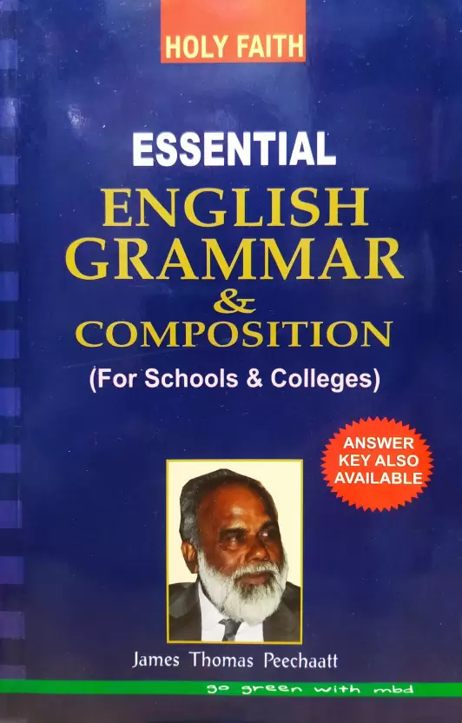
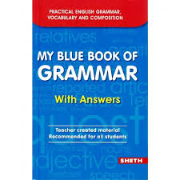

References
Book References:
1. | English Grammar & Composition, Fifth Edition, Wren & Martin by S. Chand
2. | Essential English Grammar & Composition, Seventh Edition, James Thomas by Holy book
3. | My Blue Book of Grammar, First Edition, Joseph Dominic by Sheth Publication
4. | General English English Edition by Lucent Publication

Slide 80
Thank You

